Slide 1
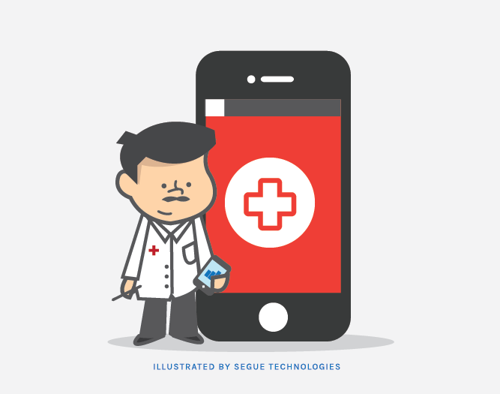
Urgent Healthcare Solutions
Group 17:
Anay Dutta
Anisha Vijayan
Saloni Kataria
Sravya Chouta

Slide 2
CONTENTS
01
Project Overview
02
Project Scope
03
Solution
04
Data Sources
05
Challenges & Deliverables
06
Next Steps
07
Conclusion

Slide 3
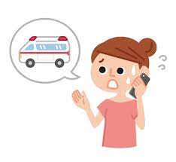

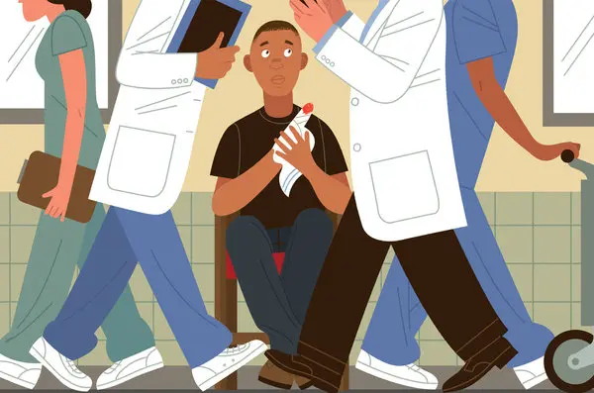
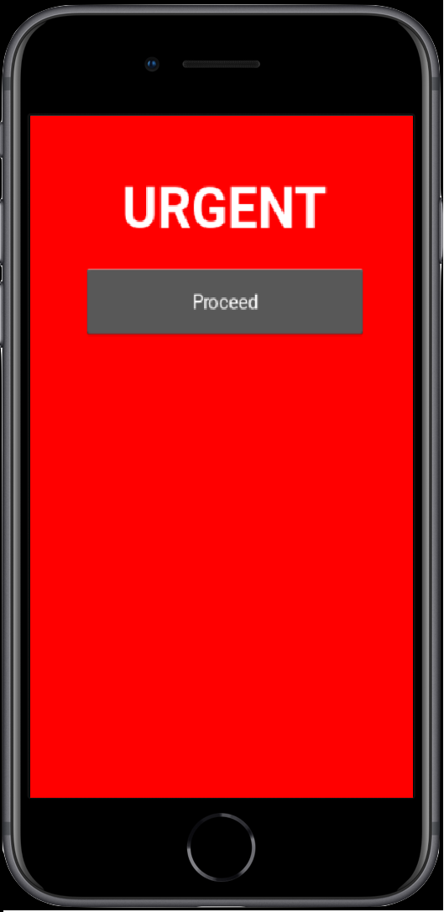
Problem
You’re in need of urgent care,
you’re panicking,
you can’t think straight,
and need to go to an urgent care facility.
Call someone or look for an urgent care on google
You go to an Urgent Care nearby and find out you’re going to be waiting an hour.
If you knew the waiting time before coming, then you would have headed to another facility for immediate care, right?
That’s where our app “URGENT” comes in!

Slide 4
Project Overview
Purpose:
App that recommends the nearest and lowest wait time urgent care facilities based on 3 important factors: distance, wait time & commute time
App gives out the “time-to-care” metric: wait time + commute time
Multi-fold Business Values:
Create a competitive advantage in the market by providing an efficient solution.
App improves operational efficiency by reducing the workload on medical staff.
App provides valuable insights into customer preferences and behavior.
Customers view wait times of facilities and pick one that meets their requirements, reducing workload from phone calls and inquiries.

Slide 5
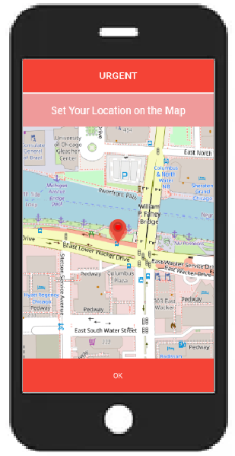
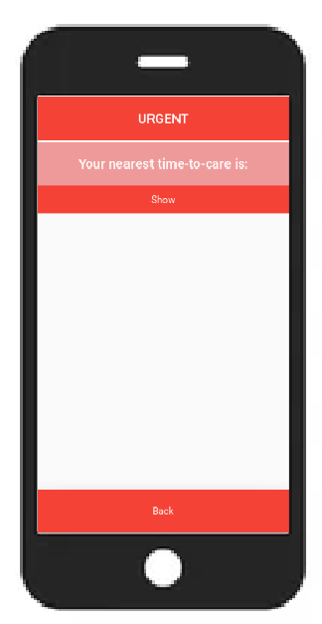
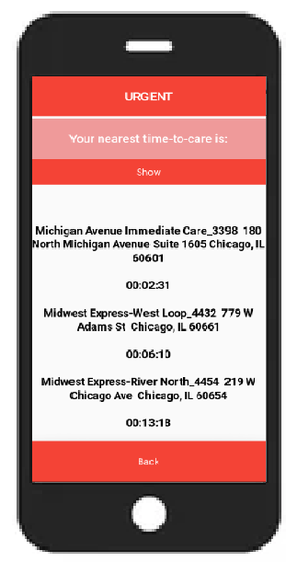
Solution: URGENT App
App named “Urgent” which would produce the list of nearest and lowest wait time urgent care facilities so that users can feel a sense of ease of transportation during an emergency.

Slide 6
Data Sources
ERTrack.net API : https://ertrack.net/api/
To see hospitals and all features of each hospital
To get the actual wait time history of a single facility
Open Source Routing Machine (OSRM)
Used to estimate the real time traffic
Time taken to reach each facility from user’s location
Geopy
Nominatim (geolocator = Nominatim(user_agent="Geolocation"))
App detects location of user using GPS in mobile device
Geodesic (geodesic(lat_lng_user, lat_lng_hosp).miles)
Can calculate geodesic distance between two points using the geodesic distance or the great-circle distance
Used for filtering nearest 8 hospitals in the vicinity of user
Notes:
We have used the ERTrack.net websites data as our main source of data. We tried to look for data sources pertaining to patients and their services as well as insurance related data to be displayed in the app, but could not find appropriate sources. ERTrack.net gives the wait time for each specific urgent cares and facilities.

Slide 7
Challenges & Solutions
Challenges | Solutions
Discrepancies in the dataset (ERTrack.net) Missing values for some facilities Server Error from the ERTrack.net for few facilities | Used KNN Imputer to impute the missing wait time values
Current wait time available; need to predict the next wait time | Examined multiple machine learning algorithms like LSTM, ARIMA and Moving Avg models for predicting the next wait times
Look for facilities in nearby states in case patient lives in the borderline region | Based on the current location of the user, facilities were fetched from current and nearby states
Consider closing/unavailability of the facilities | From historical data of wait times, estimated the closing and unavailability of each facilities
Don’t want patients to travel long distances | Adopted TOPSIS algorithm to rank the best solution
Optimization of the machine learning part | Tried to implement asyncio for optimizing the machine learning algorithm
Limited skill set for creation of Mobile App | Learned and implemented App using Kivy & Buildozer library
Notes:
TOPSIS : Technique for Order Preference by Similarity to Ideal Solution

Slide 8
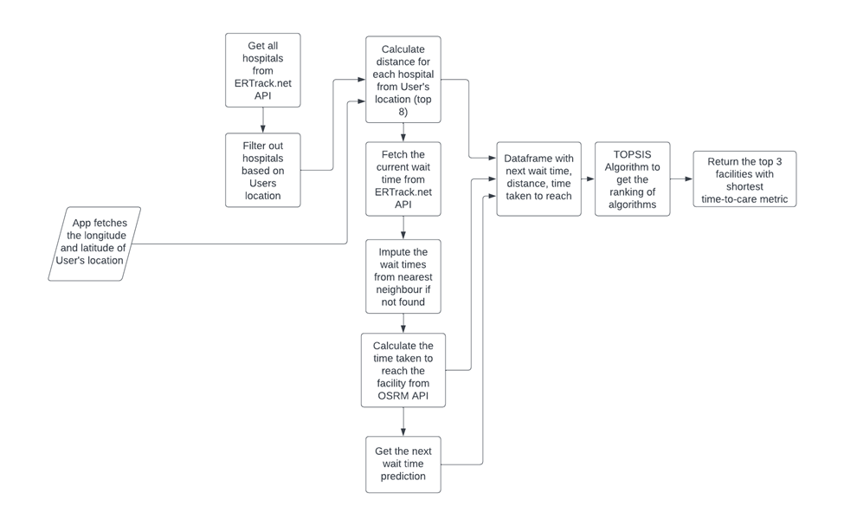
Technical Design

Slide 9
Deliverables
APK file
Source code for the App
Technical Design Specification Document
Test Cases
User Manual for the App
Incorta Certified:
Anay Dutta (Incorta 5 Essentials for Business Analysts)
Anisha Vijayan (Incorta 5 Essentials for Business Analysts,
Incorta 5 Foundations for Developers,
Incorta 5 Fundamentals for Administrators )

Slide 10
Next Steps
Phase II: Optimization of the Application
Phase II: Continued testing and development of the APK file on device
Enhance the visual aspect of the application
Add more aspects like
Links to the facilities,
Booking an Uber from the App,
Insurances covered by each facility,
Services covered by each facility

Slide 11
Conclusion
No existing solution for finding wait times at urgent care facilities during emergency situations
Incorporated multiple data sources like ERTrack.net, OSRM, Geopy to build a solution based on the hospital waiting time, distance, and estimated time to arrival
Built a Mobile Application ‘URGENT’ which gives out nearest and lowest wait time facilities based on users location
Up-and-coming: Continued enhancements and testing of the application
Fixing APK file
Optimization of the Application
Visual Enhancements

Slide 12
Thanks

